Slide 1
An Exploration into Generative Models
Dipankar Ghosh | Simran Jumani | Kushagradhi Bhowmik | Sneha Shet | Nigel Flower
Notes:
We decided to take a look into generative models for this project, so we ended up deciding on working with the Variational Autoencoder (VAE) and a Generative Adversarial Network (GAN) architectures to explore how data generating systems work.
We implemented these models over three image datasets - MNIST, labeled faces in the wild and CelebA.
Our original project idea was simply to work with GANs, but we wanted to have some sort of comparison to see how a different model would generate data points differently, and so we decided on incorporating the VAE into our project as well.
Now let’s give you all a brief outline of what these two models are, how they are trained, and how they generate data.
First we’ll look at how a VAE works, and then we’ll look at how GANs work

Slide 2
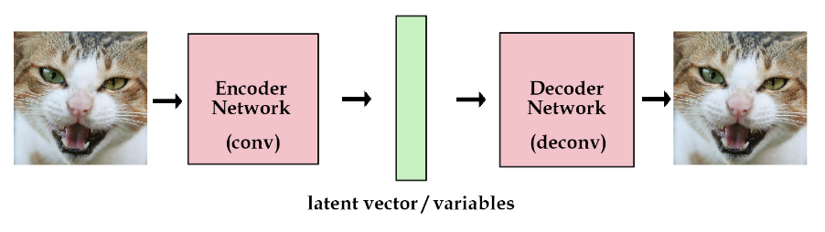
Traditional Autoencoder
Form of unsupervised learning.
Used to learn a latent representation of a given dataset.
Traditionally used in denoising data or image compression.
Image from: http://kvfrans.com/variational-autoencoders-explained/
Notes:
(Nigel)
Before we try to understand the VAE, we will first briefly look at a traditional autoencoder.
It’s an unsupervised learning method for learning a latent representation that can compress the dimensionality of data.
We train it by passing images into the encoding network, and which gives us the latent representation.
The latent representation is a vector of values with a much lower dimensionality than the original image.
Then the latent vector is decoded, which gives us an image.
We use something like mean squared error loss to train the network, taking the difference between the generated image and the original image.
It is able to encode an image into a latent representation and decode it, but it is not able to generate new data from scratch (well).
Let’s say we have a good latent representation of a cat picture. If we slightly adjust the values of the latent vector, there’s no guarantee that our generated image will simply look like a slightly different cat.

Slide 3
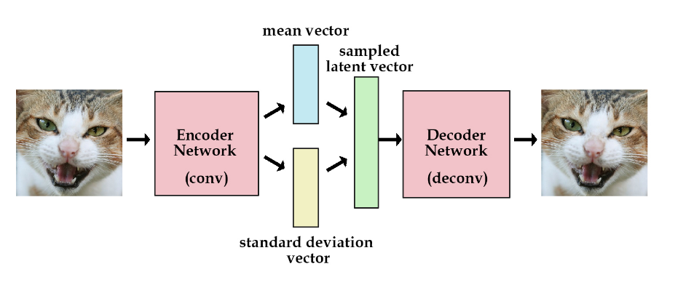
VAE (Variational Autoencoder)⁽¹⁾
Uses a similar architecture to the traditional autoencoder.
Change the latent vector layer (Kingma and Welling, 2013).
Encoder takes images and converts them into unit gaussian encodings.
Decoder network takes latent variables and deconvoles them into an image.
Now we can generate images (or other data) along a latent space without getting garbage results.
Image from: http://kvfrans.com/variational-autoencoders-explained/
Notes:
(Nigel)
The problem outlined just now can be solved by using a Variational Autoencoder.
With VAEs, we change the traditional model by imposing a constraint on the kinds of latent representations we are able to encode.
We restrict out latent representations to be distributed across a unit gaussian distribution.
The decoding part of the model is more or less the same as the traditional version, but now the way we encode latent vectors is different.
The key improvement that we make is changing the encoder such that it generates latent vectors that must be distributed across a unit gaussian distribution.

Slide 4
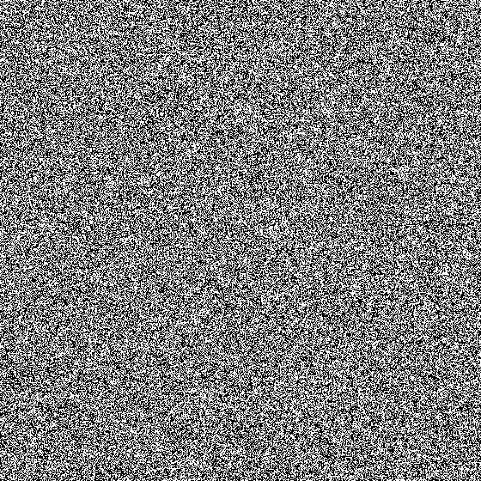
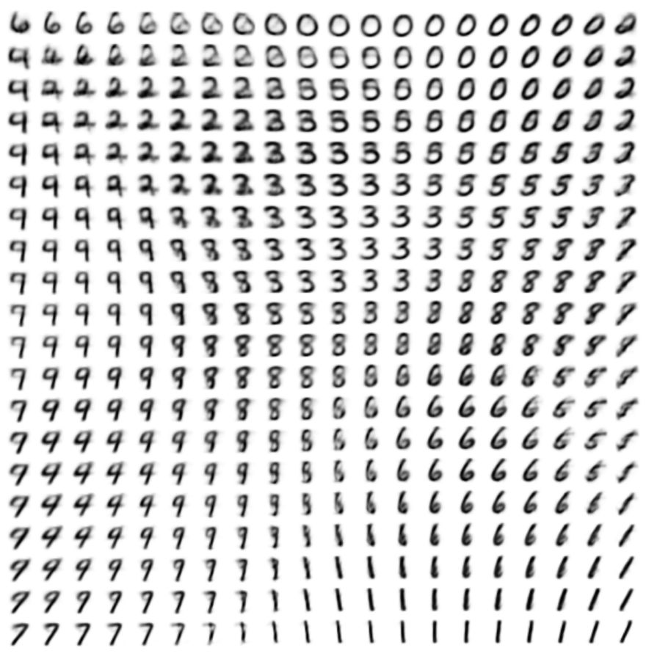
Latent Space Learned by VAE
GIF from https://jaan.io/what-is-variational-autoencoder-vae-tutorial/
Image from https://ermongroup.github.io/cs228-notes/extras/vae/
Notes:
Since now our representations are distributed across a gaussian distribution, we can say that our model learns a spatial representation of our dataset, or a latent space.
Encodings for similar data points will be closer together in this latent space.
Now, by changing values in our latent representation along one direction (two in this case) gives us a gradient of qualitative changes in the data generated.

Slide 5
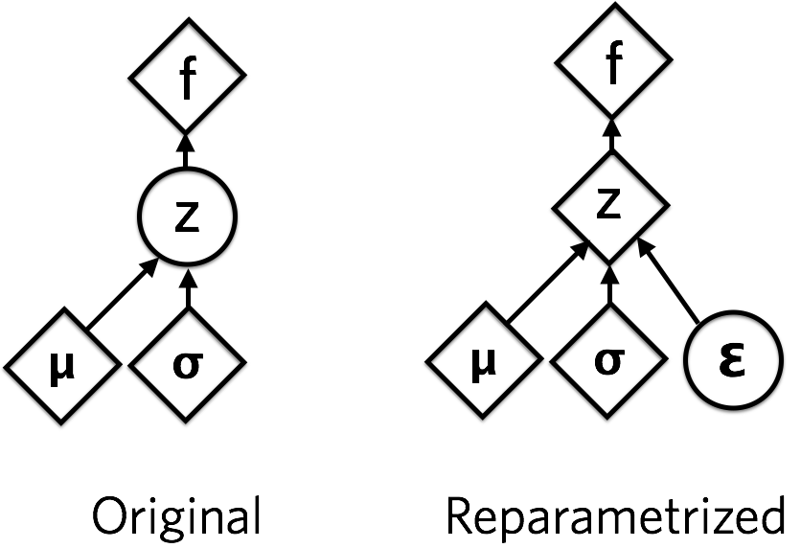
VAE Learning
Two loss functions: Generation Loss and Latent Loss.
Generation Loss is MSE of generated image and training image.
Latent Loss is KL divergence of latent vector and unit Gaussian.
“Reparameterization trick” is used in training.
Notes:
(Nigel)
We calculate the loss of a VAE using two separate loss functions added together.
So we have the generation loss is similar to that of the original autoencoder - MSE loss on the generated image with the training image
This latent loss is a new addition, which is calculated by taking the KL divergence between the latent representation of the image and the unit gaussian distribution.
The latent loss is sort of like a regularizer that forces the latent representations to be distributed across a unit gaussian distribution.
We also have this “reparameterization trick,” which involves composing the latent vector of two separate vectors, a mean and a STD.
The standard deviation vector is multiplied element-wise with a unit gaussian vector of noise to introduce stochasticity into the model.
The added stochasticity allows our model to generalize better (won’t go into why this is right now)

Slide 6
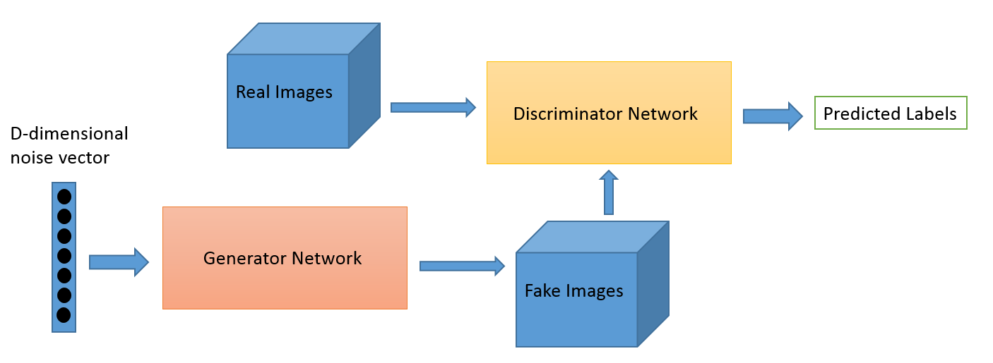
GAN (Generative Adversarial Network)
Generative models (devised by Ian Goodfellow in 2014)
Two differentiable functions (as neural networks) are locked in a game (adversarial process)
Generative model G captures the data distribution
Discriminative model D estimates the probability that a sample came from the training data rather than G.
Training procedure for G is to maximize the probability of D making a mistake.
Notes:
The second model that we decided to implement was, of course, the GAN.
This model is comprised of two networks similar to the VAE.
Much like the VAE, the generator network generates data from a latent vector
The generator network is responsible for generating data, and the discriminator network basically tries to tell whether the data point it’s presented is from the training data or from the generator network.
These two networks are adversarial in the sense that they are trying to minimize their costs at the expense of the other network.

Slide 7
GAN Learning Mechanism
Generator & Discriminator is held constant while training the other. Training alternates between the two.
Training the Discriminator
Simple binary classification task - given an image, predicts whether the image is real / artificial.
Real images from train set, label → 1 Artificial images, label → 0, by passing a random vector to the Generator and getting its output. Binary Cross Entropy is used as the loss function and the weights are updated using Back-propagation.
Training the Generator
Random vector passed to the Generator G as input
Output (artificial image) of G passed via the Discriminator to make a prediction
The label is taken as 1, since we want the Generator to produce such images for which the Discriminator would predict 1.
If it doesn’t predict 1, then the error (Binary Cross Entropy) is back-propagated and only the Generator weights are updated.
Notes:
Training the Discriminator: Simple binary classification task, where given an image as input, it has to predict whether the image is real or artificial. So we give the real images from train set with label = 1, and artificial images with label = 0, by passing a random vector to the Generator and getting its output. Binary Cross Entropy is used as the loss function and the weights are updated using Back-propagation.
Throughout each training step, we generate a batch of fake data from the generator network.
We run the batch of training images and fake images through the discriminator network.
The loss of the generator network is calculated simply by taking the cross entropy between a vector of ones and the computed output of the fake images passed through the discriminator
This means, if our discriminator output all ones (i.e. thinks that our generated data is all real), then this is really good
If the discriminator determines that all of our generated data is fake, then this is bad
The loss of the discriminator network is calculated by adding up the “real loss” and the “fake loss”
“Real loss” means how well we classified the real images
“Fake loss” means how well we classified the images made by our generator

Slide 8
MNIST Dataset⁽¹⁾
(1) "Gradient-based learning applied to document recognition." Y. LeCun, L. Bottou, Y. Bengio, and P. Haffner, 1998

Slide 9
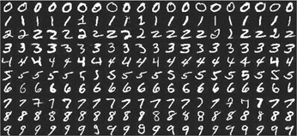
Sample from the Data set

Slide 10
VAE model architecture on MNIST
Encoder Network:
Input Layer: 28 x 28 x 1
Convolutional Layer: 32 filters, kernel size of 3, stride of 2, relu activation function
Convolutional Layer: 64 filters, kernel size of 3, stride of 2, relu activation function
Dense Layer: 2 x latent_dim
Generative Network:
Input Layer: latent_dim number of neurons
Dense Layer: 7 * 7 * 32
Reshape into (7, 7, 32) channels
Transposed Convolutional Layer: 64 filters, kernel of size 3, stride of 2, relu activation function
Transposed Convolutional Layer: 32 filters, kernel of size 3, stride of 2, relu activation function
Transposed Convolutional Layer: 1 filter, kernel of size 3, stride of 1, relu activation function
Notes:
Latent space: 100 O/p: 28*28*1
Encoder: 2 conv layers
Decoder: 3 Deconv

Slide 11
GAN model architecture on MNIST
Generator Model:
Input Layer: 100
Dense Layer: 7 * 7 * 256,, leaky relu activation function
Transposed Convolutional Layer: 128 filters, kernel of size 5, stride of 1, leaky relu activation function
Transposed Convolutional Layer: 64 filters, kernel of size 5, stride of 2, leaky relu activation function
Transposed Convolutional Layer: 1 filter, kernel of size 5, stride of 2, tanh activation function
Discriminator Model:
Input Layer: 28 x 28 x 1
Convolutional Layer: 64 filters, kernel of size 5, stride of 2, leaky relu activation function
Dropout Layer: 0.3
Convolutional Layer: 128 filters, kernel of size 5, stride of 2, leaky relu activation function
Dropout Layer: 0.3
Sigmoid output neuron

Slide 12
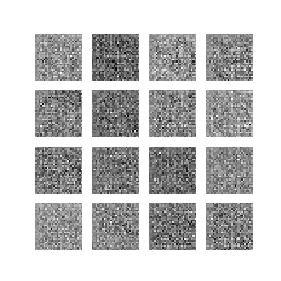
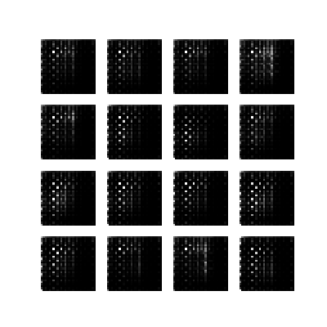
MNIST Results
VAE
GAN
Notes:
Generated data for 50 epochs
The data generated by the VAE: Since VAE uses MSE, the images are a bit blurrier.
The data generated by the GAN: Images look a bit crisper, but not as “number-like” than the ones generated by VAE
Contrast between transition smoothness for both models, and probable reason behind that.

Slide 13
Labeled Faces in the Wild Dataset⁽¹⁾
(1) “Labeled Faces in the Wild: A Database for Studying Face Recognition in Unconstrained Environments” Huang G., Ramesh M., Berg T. Learned-Miller E., 2007

Slide 14
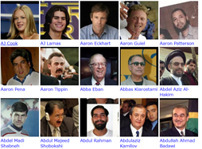
Sample from LFW Dataset
Notes:
13k images in the dataset

Slide 15

dense
ENCODER
mu
Z
64*64*3
32*32*64
16*16*128
8*8*256
4*4*512
sigma
512
Z
reshape
DECODER
8192
512
512
8*8*256
16*16*128
32*32*64
64*64*3
Notes:
Latent size : 512

Slide 16
GAN model architecture on LFW
DISCRIMINATOR
0/1
Reshape
conv, dropout
conv, dropout
conv, dropout
flatten
Dense
160*160*3
40*40*3
18*18*256
14*14*128
10*10*64
128
GENERATOR
6400
Noise vector
Dropout, BN,Deconv
Dense, dropout, BN, Reshape
Dropout, bn, Deconv
Dropout, BN, Deconv
Deconv
Z
40*40*3
100
80*80*256
160*160*128*
160*160*64
160*160*3

Slide 17
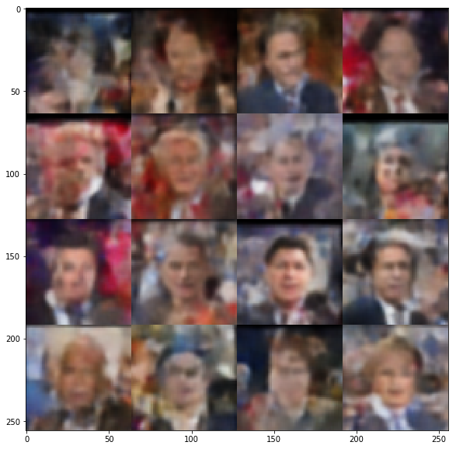
VAE- LFW Results
Notes:
500

Slide 18
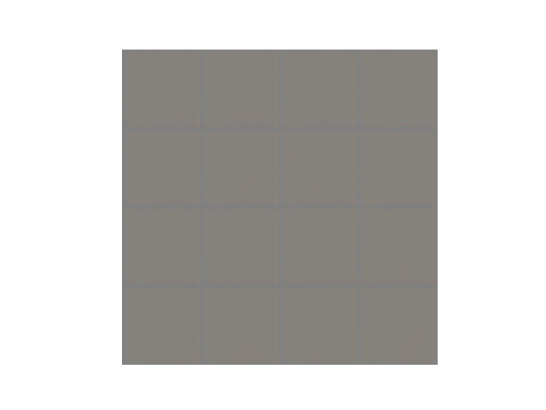
GAN- LFW Results

Slide 19
CelebA Dataset⁽¹⁾
(1) “Deep Learning Face Attributes in the Wild” Liu Z., Luo P., Wang X., Tang X., ICCV 2015

Slide 20
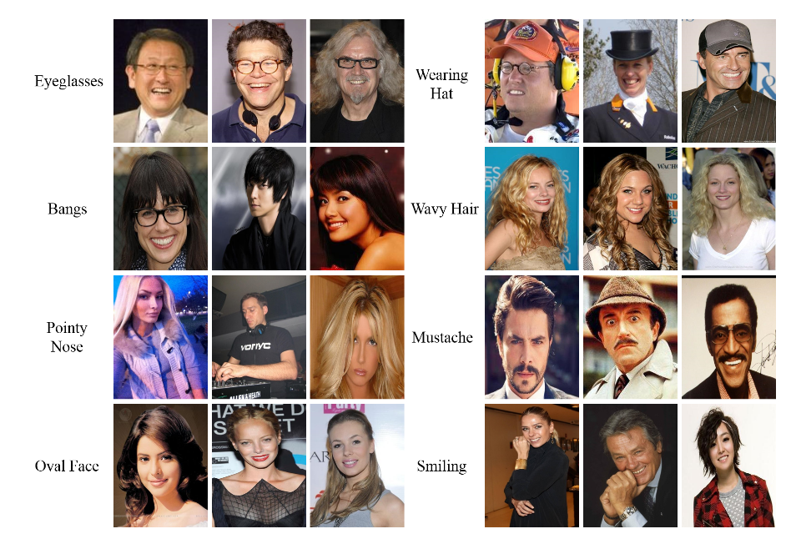
Sample from the CelebA dataset
Notes:
One of the reasons we picked this dataset is because it has a lot of variation in terms of styles used by humans- glasses, earphones, hats, mustaches, hairstyles etc

Slide 21
VAE model architecture on CelebA
mu
ENCODER
conv,
bn
conv,
bn
conv,
bn
conv,
bn
fc, flatten
64*64*3
32*32*64
16*16*128
8*8*256
4*4*512
sigma
DECODER
8192
64
sample
mu
fc, reshape
deconv,
bn
deconv,
bn
deconv,
bn
deconv
sigma
Z
64
64
4*4*512
8*8*256
16*16*128
32*32*64
64*64*3
Notes:
Leaky ReLU alpha - 0.2
bn - batch normalization
Filter size: 5

Slide 22
DISCRIMINATOR
Real / Fake
1 / 0
Conv, bn, lrelu
Conv, bn, lrelu
Conv, bn, lrelu
Flatten, FC, relu
FC, sigmoid
64*64*3
32*32*128
16*16*256
8*8*512
1024
Noise vector
GENERATOR
Deconv, bn, relu
Deconv, bn, relu
Deconv, bn, relu
Deconv, bn, tanh
FC, bn, relu, reshape
Z
100
8*8*128
8*8*128
16*16*128
32*32*64
64*64*3
Notes:
Generator
Input Layer: 100 x 1 (random noise vector drawn from a normal distribution)
Fully Connected Layer: 128 * 8 * 8
Batch Normalization Layer, ReLU Activation Function
Reshape Layer: 8, 8, 128
2D Convolutional Transpose Layer: 128 filters, kernel size of 4, stride of 1
Batch Normalization Layer, ReLU Activation Function
2D Convolutional Transpose Layer: 64 filters, kernel size of 4, stride of 2
Batch Normalization Layer, ReLU Activation Function
2D Convolutional Transpose Layer: 32 filters, kernel size of 4, stride of 2
Batch Normalization Layer, ReLU Activation Function
2D Convolutional Transpose Layer: 3 filters, kernel size of 4, stride of 2, Tanh Activation Function
Discriminator
Input Layer: 64, 64, 3
2D Convolutional Layer: 128 filters, kernel size of 4, stride of 2
Batch Normalization Layer, Leaky ReLU Activation Function
2D Convolutional Layer: 256 filters, kernel size of 4, stride of 2
Batch Normalization Layer, Leaky ReLU Activation Function
2D Convolutional Layer: 512 filters, kernel size of 4, stride of 1
Batch Normalization Layer, Leaky ReLU Activation Function
Fully Connected Layer: 1024, ReLU Activation Function
Fully Connected Layer: 1, Sigmoid Activation Function

Slide 23
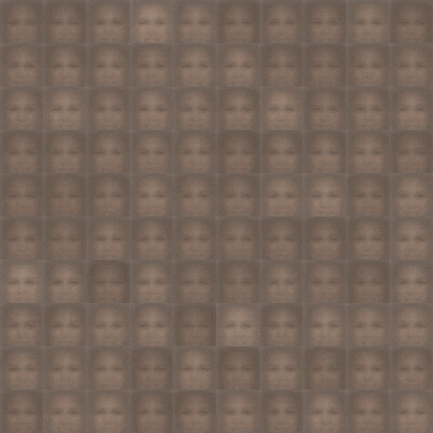
VAE- CelebA Results
After 20 epochs
Notes:
Stats:
Training set size : 202k | 202,000 | 202,599
Single image size 64 x 64 x 3
Epochs 20
Training time ~ 5 hours with batch normalization
Platform nVidia GeForce GTX 1050 Ti Max-Q | compute capability: 6.1 | GPU mem: 4 GB
Optimizer Adam ( learning rate - 0.0002 )

Slide 24
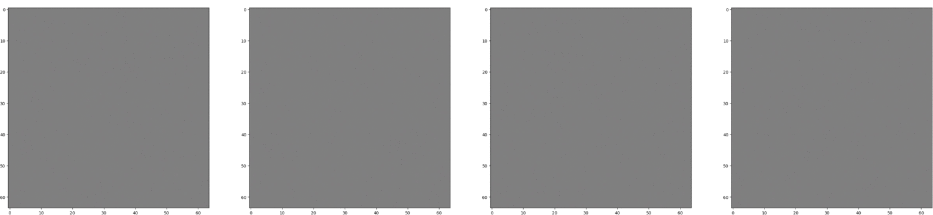
GAN - CelebA Results
Notes:
Train set size: 200,000
Image shape (original): (218, 178, 3)
Image shape (resized): (64, 64, 3), mean normalized
Batch size: 512
#Epochs: 60
Total time taken: 12 hours
GPU: NVIDIA K80 on AWS EC2 P2 instance with 12GB GPU RAM
Optimizer = Adam, with learning rate 0.0002
Obtained very similar generated images from epoch 50 onwards

Slide 25
Possible Future Work
Be more systematic in comparing our models
Explore different hyperparameter settings for each model
Try more complex architecture for GAN in order to get better output
Try higher resolution input images for GAN
Try using GANs with latent vectors: http://blog.otoro.net/2016/04/01/generating-large-images-from-latent-vectors/

Slide 26
Thank You!
Questions?

